Slide 1

Group 3
Franco – Data collection and basic cleaning. Analysis for house price and train stations
Nasrin – Analysis for house price and distance between CBD
Catherine – Analysis for house price and crime rate
Joseph – Analysis for house price and school number and finalize
Notes:
Franco – data collection and cleaning train stations
Nasrin – distance between CBD
Catherine – crime rate
Joseph – school number and finalize

Slide 2
House Price ANALYSIS
Notes:
Franco

Slide 3

Why this topic
Majority of the people would like to settle down at some point of life, eventually we would all need to buy a property. House price could directly affect to the plan of life.
Notes:
Franco

Slide 4

Key Steps for the analysis
Find and filter reliable historical data
Determine the factors that will affect the house price and search for relevant dataset
Set up hypotheses
Look into the factors by analyzing the data we have
Notes:
Find and filter reliable historical data
Determine the factors that will affect the house price and search for relevant dataset
Set up hypotheses
Look into the factors by analyzing the data we have
Fine tune the analysis to find the correlation between the factors

Slide 5

Data source for analysis
House sales record from 2016 – 2018 that covers over 30,000 record and 345 suburbs – CSV from Kaggle
List of all the schools in Melbourne – no school rating – CSV from Victoria Government website
Crime rate data – CSV from Victoria Government website
Latitude, Longitude of center of suburbs and surrounding train stations – Google API call
Note: The analysis used data from 2016-2018 because market behaviour changed afterward due to COVID pandemic
Notes:
House sales record from 2016 – 2018 that covers over 30,000 record and 345 suburbs – from Kaggle
List of all the schools in Melbourne – no school rating – from Victoria Government website
Crime rate data – Victoria Government website
Latitude, Longitude of center of suburbs and surrounding train stations – Google API call
Note: The analysis used data from 2016-2018 because market behaviour changed afterward due to COVID pandemic

Slide 6
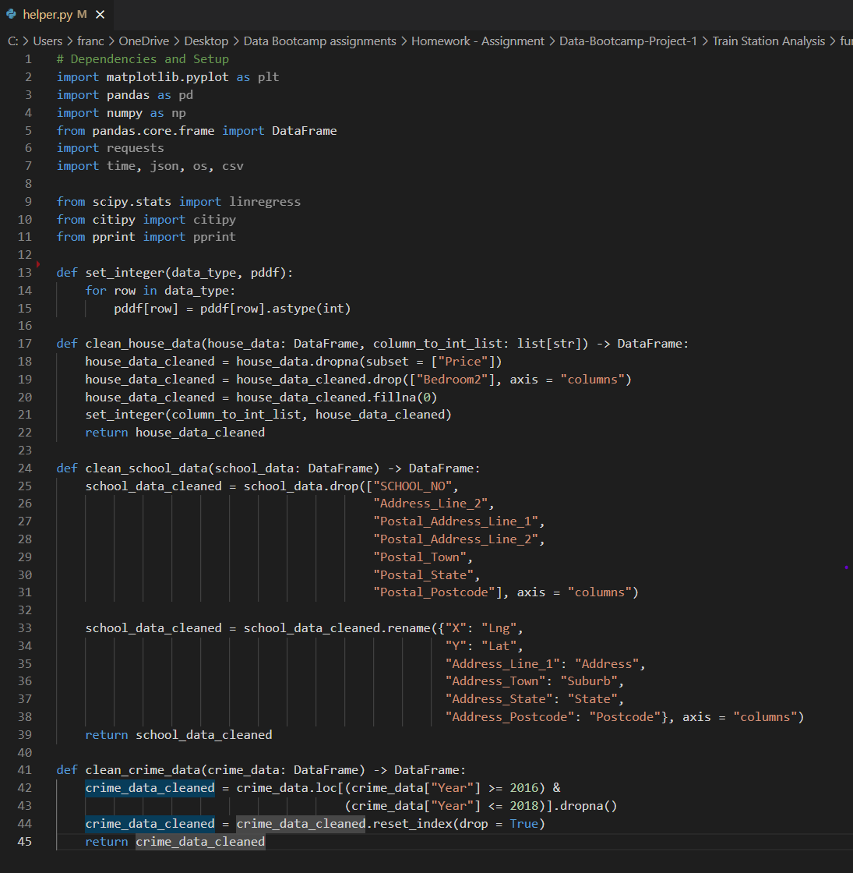
Creating helper file
Define functions to do basic data cleaning
Notes:
Functions include fill Na, rename columns, change data types, filter and drop columns
Functions are customized for specific dataset.

Slide 7
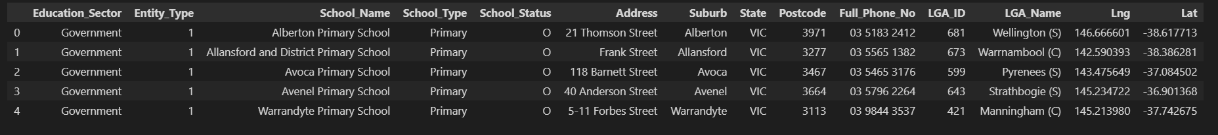
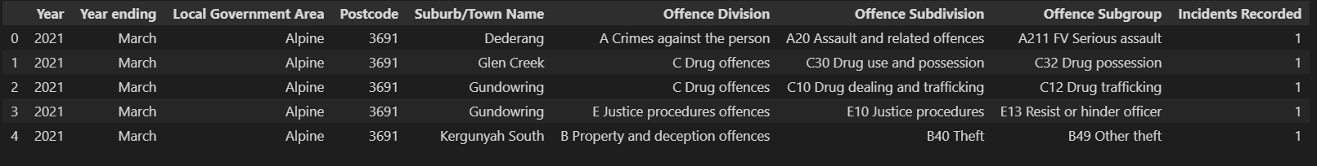
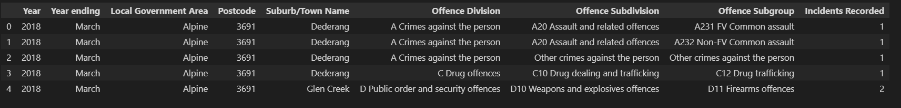
General Data Cleaning
Before
After
Drop rows that contains no sales record
Drop unwanted columns
Rename column names for easier recognition
Change data type for easier calculation
Before
After
Before
After
Notes:
Drop rows that contains no sales record
Drop unwanted columns
Rename column names for easier recognition
Change data type for easier calculation

Slide 8
HypothesIs 1:
A positive relationship between the house price and the number of train station surrounding the suburb
Notes:
Closer to a train station or more options of train stations means more convenience.
Some people in those area rarely drive. In saying that they save some budget on maintaining a vehicle, so it sounds reasonable for those suburbs to have a higher house price.
This analysis is based on this to ry and prove this relationship.

Slide 9
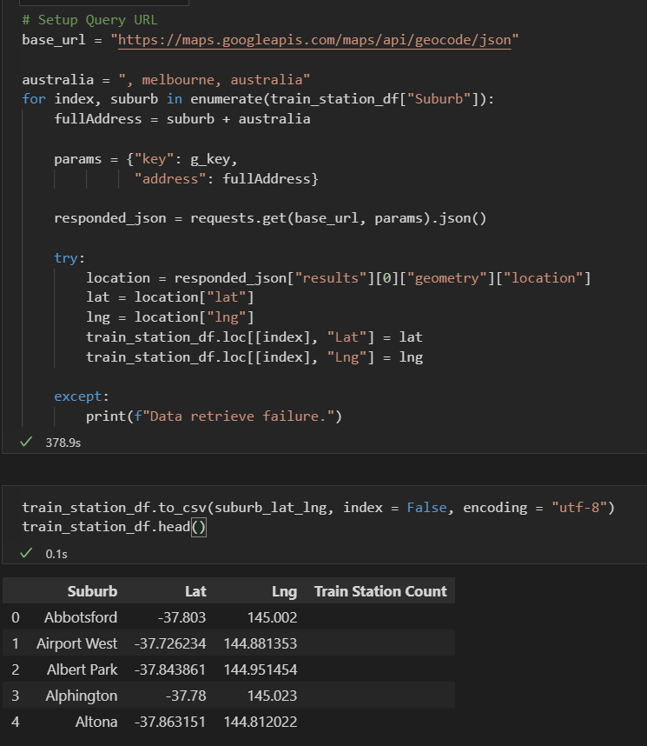
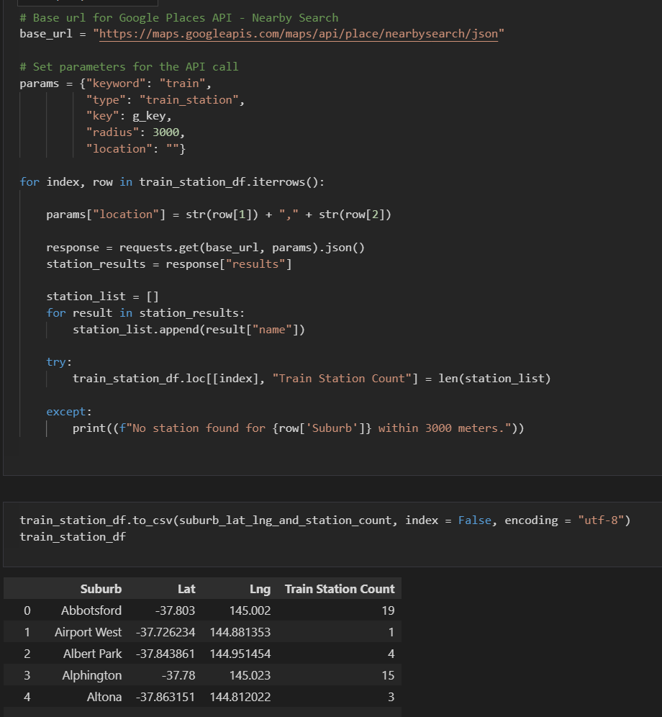
Collect Data via Google API call
Notes:
First API call is Geocode call to try find and out the center point of a suburb for the next part
Second call is a nearby search to find the train stations surround a suburb within 3 km radius
Out of all the data source, Google map system is by far the most accurate and widely used for location search, thus I chose google API

Slide 10
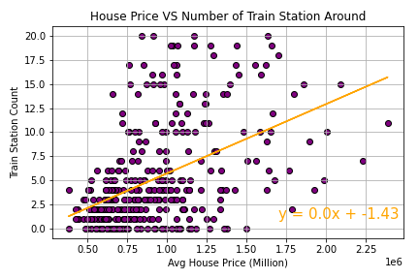
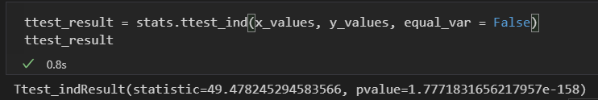
Conclusion based on this analysis: House price and number of train stations surrounding have a positive relationship
Notes:
Conclusion is the more train station around the suburb the higher the house price
Limitation of the data : just 3 year period ; we are just getting the sales price overall.

Slide 11
hypothesis 2:
The distance from CBD has direct correlation to the house pricing.
The closer to the CBD, the higher the house price

Slide 12
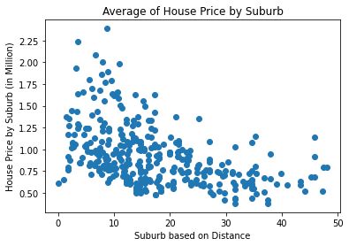
All house prices in all suburbs
Correlation Coefficient : -0.46 0.3 <r <0.5 => Weak Relationship
Notes:
Nasrin – explain the X-axis and Y-axis

Slide 13
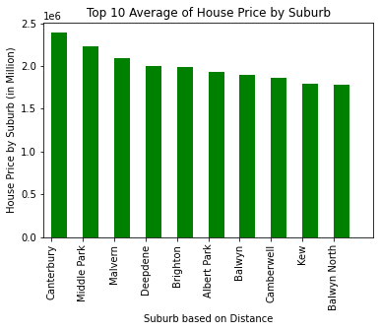
Top 10 highest house prices by suburbs
Downward Trend

Slide 14
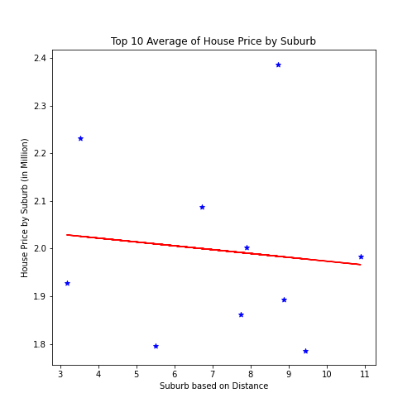
Top 10 highest house prices by suburbs
Y= -0.01 X + 2.05
Correlation Coefficient : -0.46 <0.5 P-value: 0.77 >0.05 (H0) is approved

Slide 15
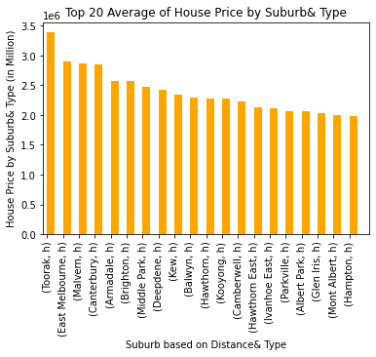
Top 20 highest house prices by suburb & type
Downward Trend (House Type: House)

Slide 16
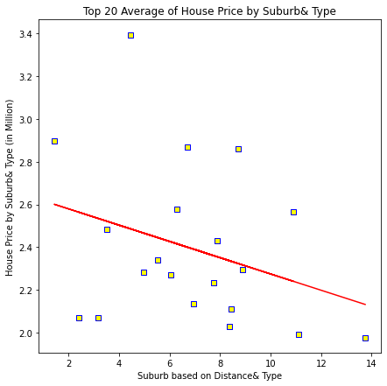
Top 20 highest house prices by suburbs & type
Y= -0.04 X + 2.66 Correlation Coefficient : -0.31 <0.5 P-value: 0.17 >0.05 (H0) is approved

Slide 17
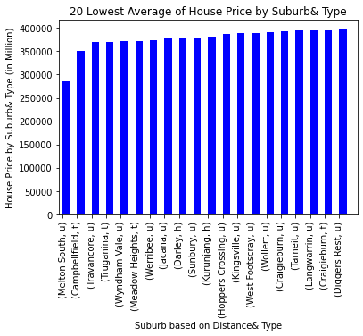
20 lowest house prices by suburb& type
Upward Trend Majority townhouse and unit type

Slide 18
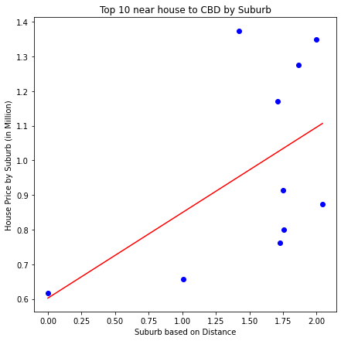
Top 10 nearest house to CBD by suburb
Y= 0.25 X + 0.6 Correlation Coefficient : 0.53 >0.5 P-value: 0.11 >0.05 (H0) is approved

Slide 19
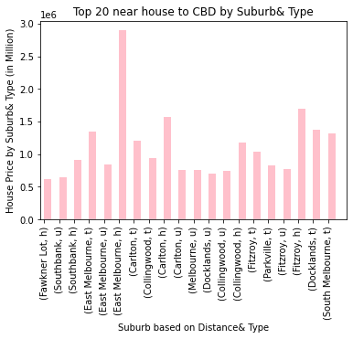
Top 20 nearest houses to CBD by suburb & type
Upward Trend All house type

Slide 20
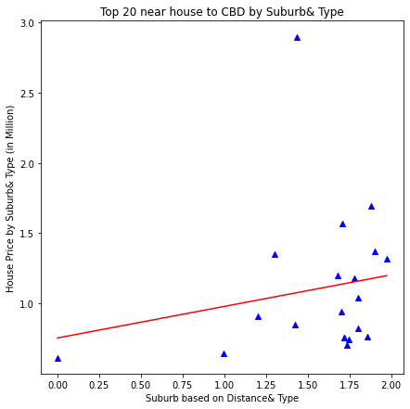
Top 20 nearest houses to CBD by suburb & type
Y= 0.22 X + 0.76 Correlation Coefficient : 0.19 < 0.5 P-value: 0.42 >0.05 (H0) is approved

Slide 21
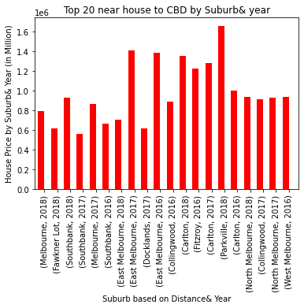
Top 20 nearest houses to CBD by suburb & year
Upward Trend Majority from 2018

Slide 22
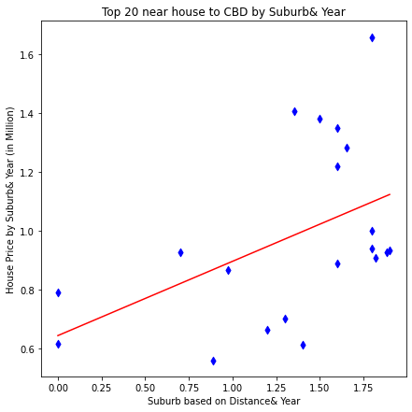
Top 20 nearest houses to CBD by suburb & year
Y= 0.25 X + 0.64 Correlation Coefficient : 0.47 < 0.5 P-value: 0.03<0.05 (H0) is rejected

Slide 23
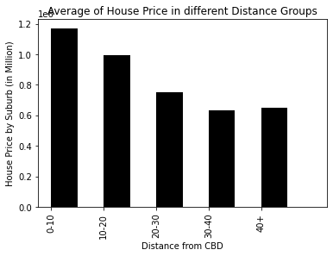
Average of house prices in different distance groups (bins)
Downward Trend

Slide 24
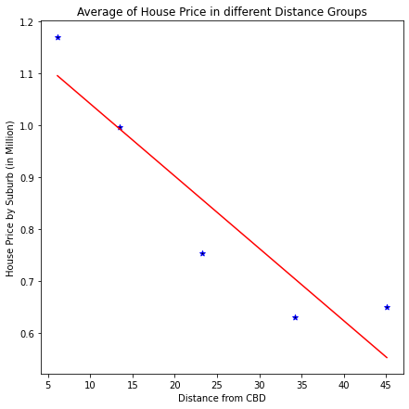
Average of house prices in different distance groups (bins)
Y= -0.01 X + 1.18 Correlation Coefficient : -0.93 > 0.5 P-value: 0.02<0.05 (H0) is rejected

Slide 25
Conclusion for Hypothesis 2:
Negative relationship between average of house price and distance to Melbourne CBD
(The closer to the CBD the higher the house price)

Slide 26
HypothesIs 3:
Crime rate will affect the house price negatively. The higher the crime rate in the suburb, the less likely the house price will increase

Slide 27
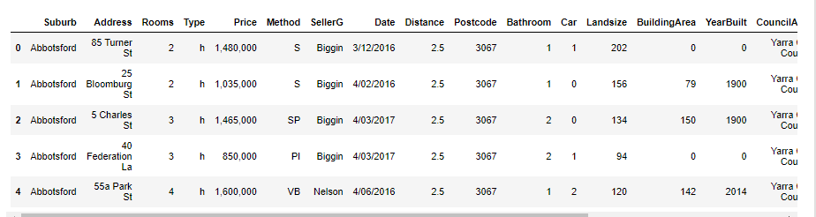
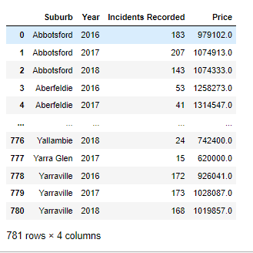
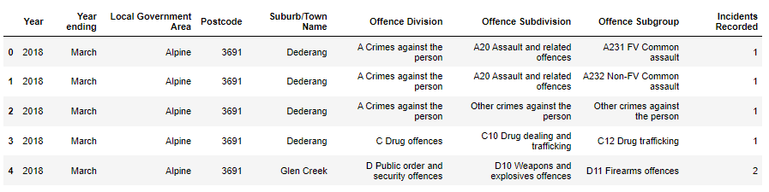
Data Cleaning
Group by (aggregate method) to see the summary results
Drop unwanted columns to make readings easier
Crime dataset- initial we have >100k rows and 9 columns
Final dataset has only 3 columns
Merge both data frames
Rename column names for easier understanding
Housing data – changing the datatype of the sales price – from object to float

Slide 28
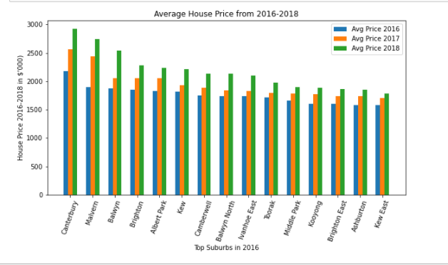

Look at the Past market trends
Top Suburbs house prices trend

Slide 29
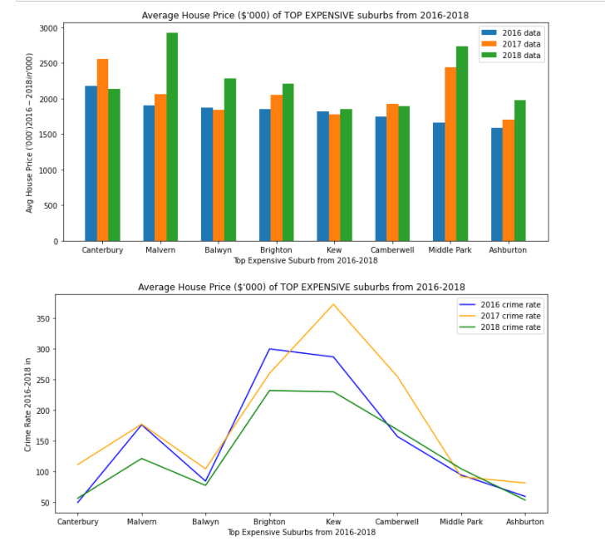
Evidence of Data Exploration
Select the top expensive suburbs from 2016-2018
Find out the crime rate (2016-2018) for the selected suburbs

Slide 30
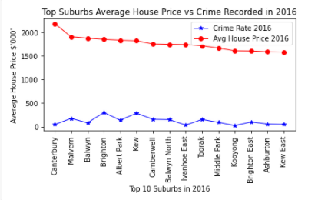
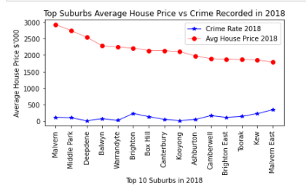
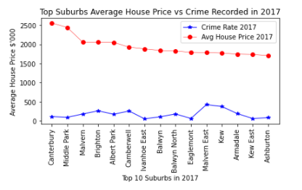
Deep Dive – The top expensive suburbs for each year How does the crime rate look like?
The most expensive suburbs that will have lower crime rate?
Seems like some less expensive suburbs also have low crime rate….

Slide 31
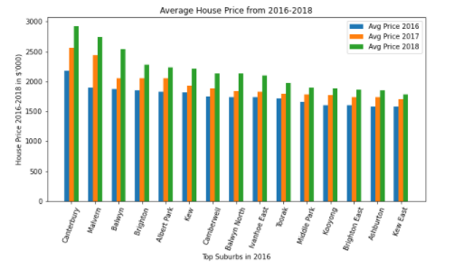
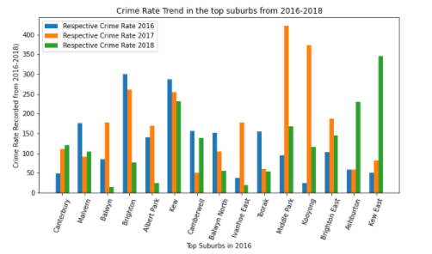
Narrowing down… Only selecting the top suburbs in 2016 to see the trend over the years

Slide 32
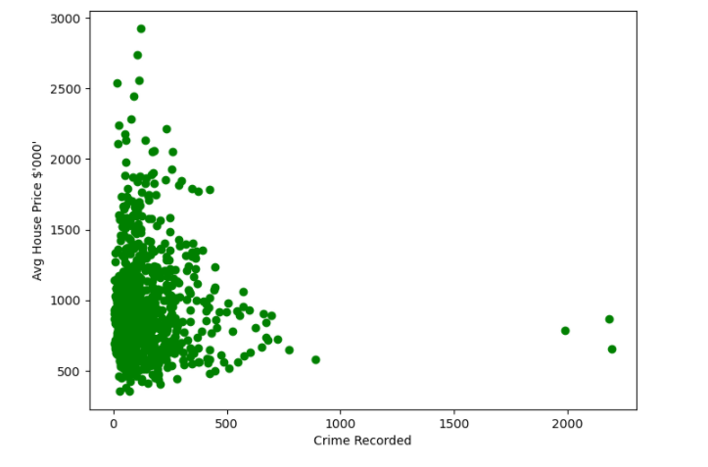
Evidence of Data Exploration Scatter plot
We have paired numerical data
Trying to find out if the two variables are related
For this instance, trying to find out if CRIME RATE is the potential cause of the rise of house price?
Crime rate vs Avg House Price (by the suburbs)
(2016 – 2018)

Slide 33
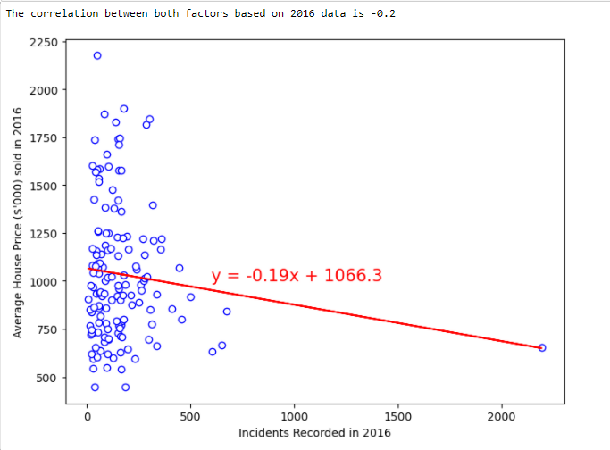
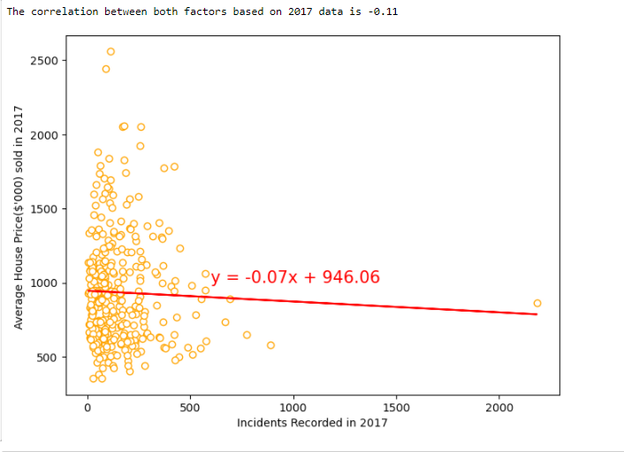
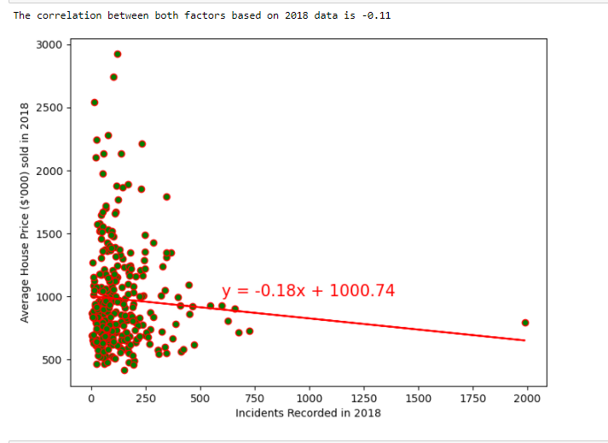
Data Exploration Scatter plot for each year
Crime rate vs Avg House Price (by the suburbs)
- Negative correlation…?

Slide 34
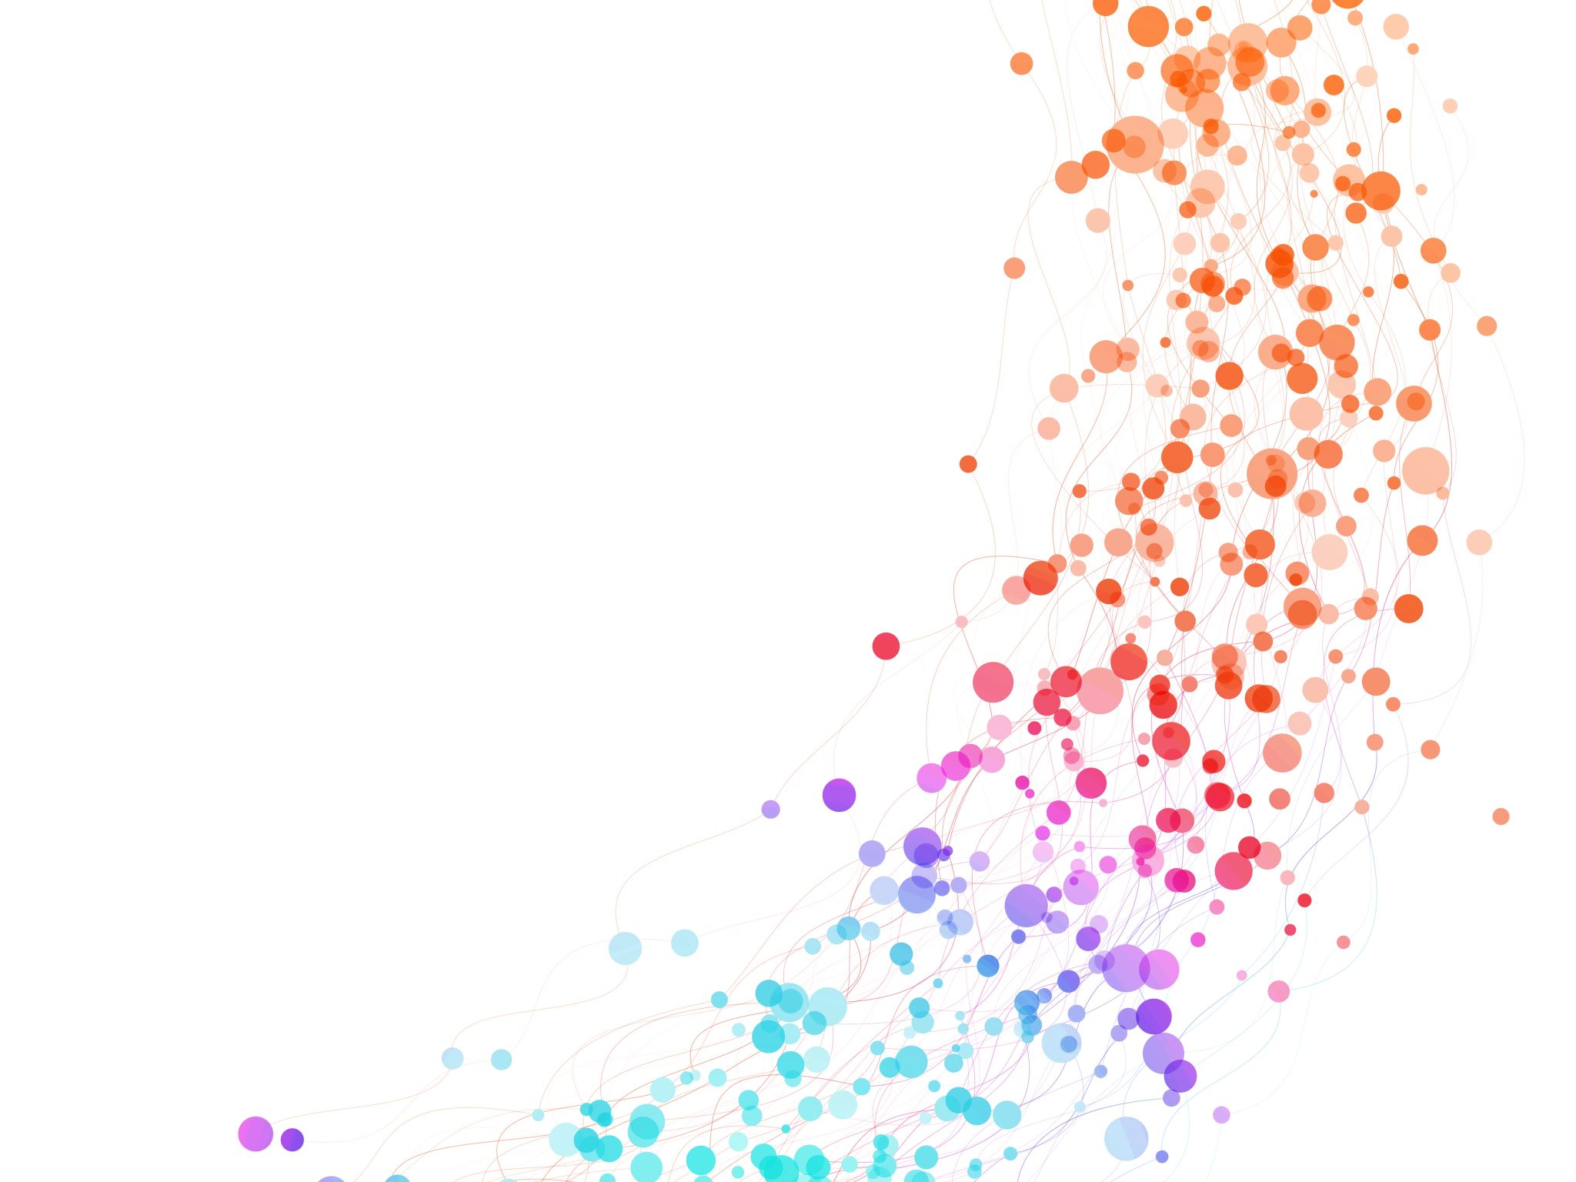
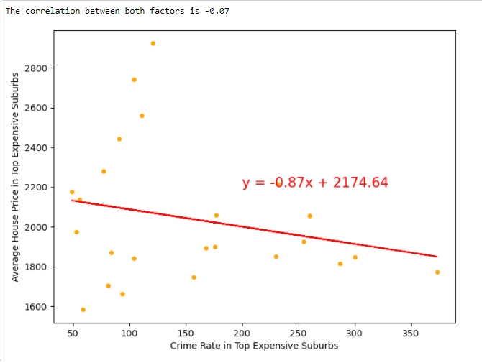
Correlation Analysis for Top Expensive Suburbs
Negative correlation between the two factors

Slide 35
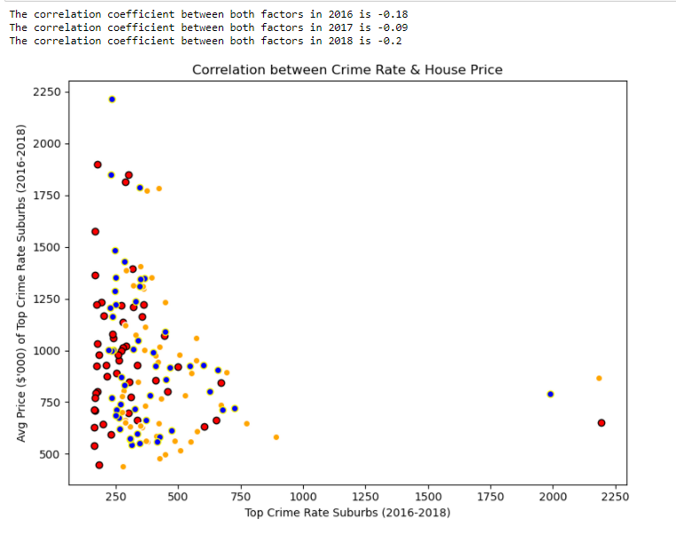
Correlation Analysis for Top Crime Rate Suburbs
Top crime rate suburbs for each year, with their average house price
It seems like there’s a negative correlation between both factors

Slide 36
Summary of findings
Overall data exploration by each year
Top expensive suburbs vs Crime rate– by each year
Top crime rate suburbs vs House Price – by each year
Back to Hypotheses:
Crime rate will affect the house price negatively.
This proves that the hypotheses is correct
Positive house price trend
Crime rate varies for each year
Negative correlation
Negative correlation

Slide 37
hypothesis 4:
School is one of the main reasons for the surge in house prices of specific suburb. Both private and public school play a big role when it comes to choosing the right suburb to live in.

Slide 38
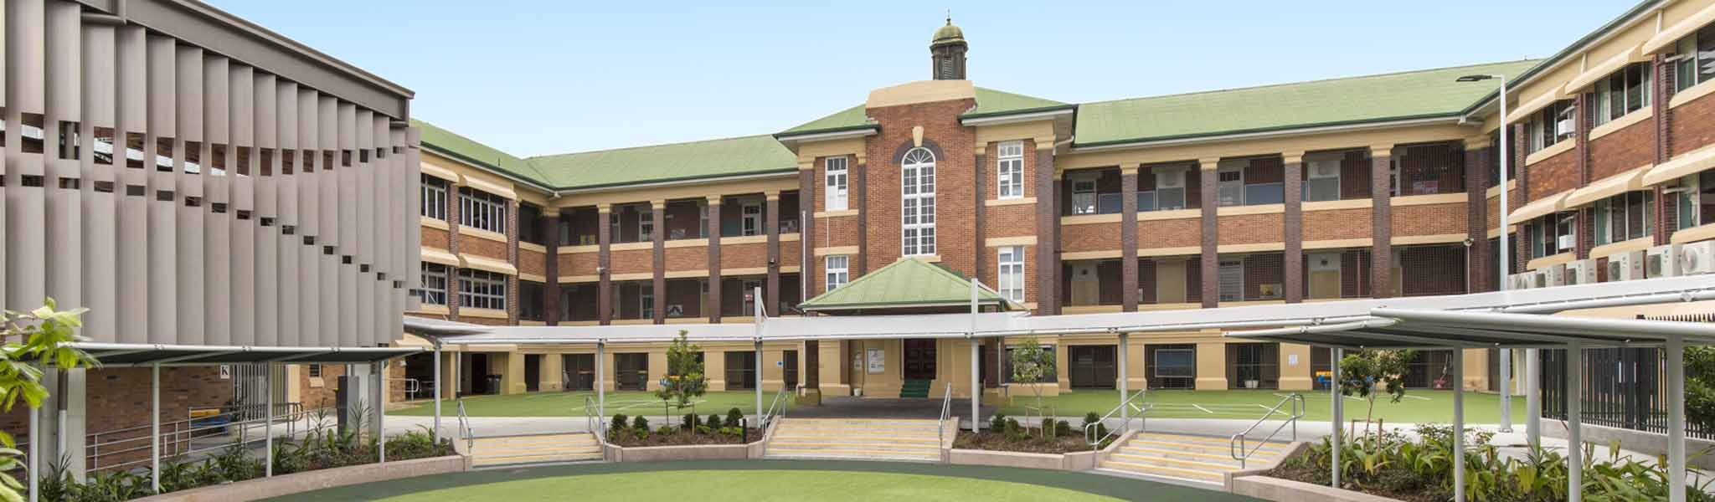
The House prices in a suburb are affected by the number of Schools in that suburb

Slide 39

Melbourne Housing Sales Dataset
Schools Dataset

Slide 40
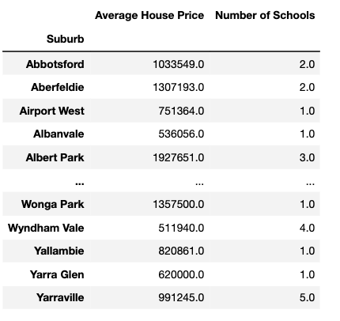
Obtain Values
Average House Price
Each Suburb
Vs
Number of Schools
Each suburb

Slide 41
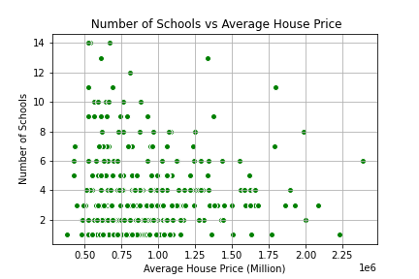
Even if there are 10 -14 schools in some suburbs.. the Average House Price stayed around 500 k to 750 k
Houses over 1.25 mil does not necessarily have a lot of Schools in their respective suburbs

Slide 42
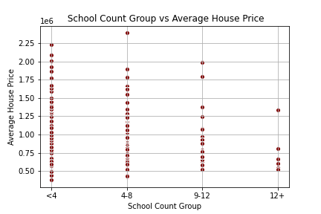
School Count - Binning
To get a better picture we made Groups based on School Count
We have a lot of suburbs with school count less than 4
But that did not really really stop suburbs having high House prices

Slide 43
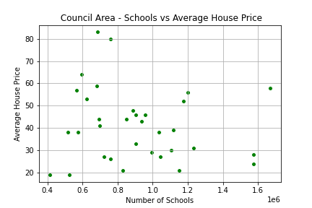
Based on Council Area
To get a different angle of this Visualisation
We got the Average house price of each Council and compared that to number of Schools in that council
And still the distribution was quite even
Not much relation going on here

Slide 44
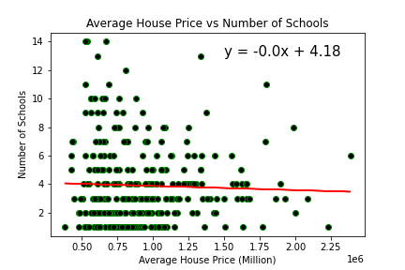
Average House Price
VS
School Count
Line equation
The correlation coefficient is -0.04
A slight negative correlation

Slide 45
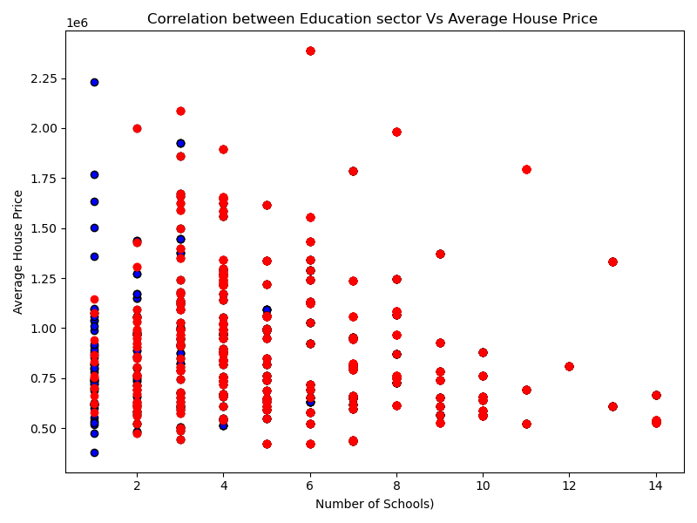
Impact of
Government
vs
Private Schools
On
House prices

Slide 46
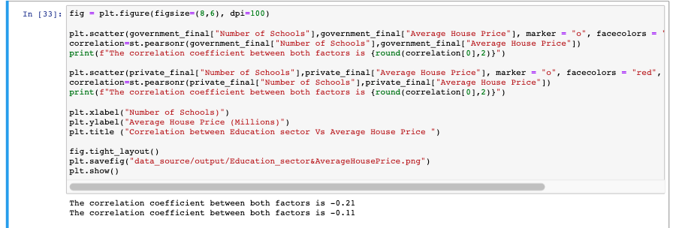
The correlation coefficient between Government schools and House Price is -0.21
The correlation coefficient between Private Schools and House Price is -0.11
Private schools have a better impact on House Prices compared to Government Schools

Slide 47
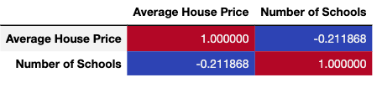
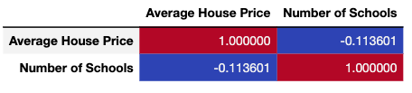
Government Vs Private - Corr()
Government Schools
The correlation coefficient between Private Schools and House Price is -0.21
Private Schools
The correlation coefficient between Private Schools and House Price is -0.11

Slide 48
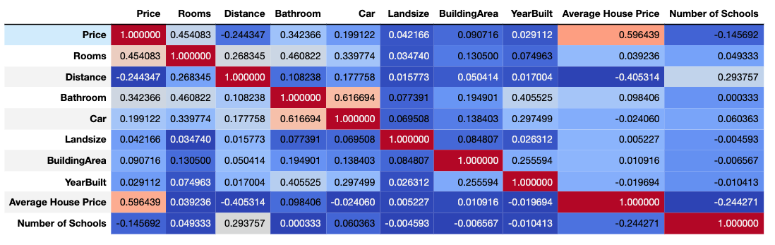
Overall Correlation - Different Factors vs House Prices

